Slide 1
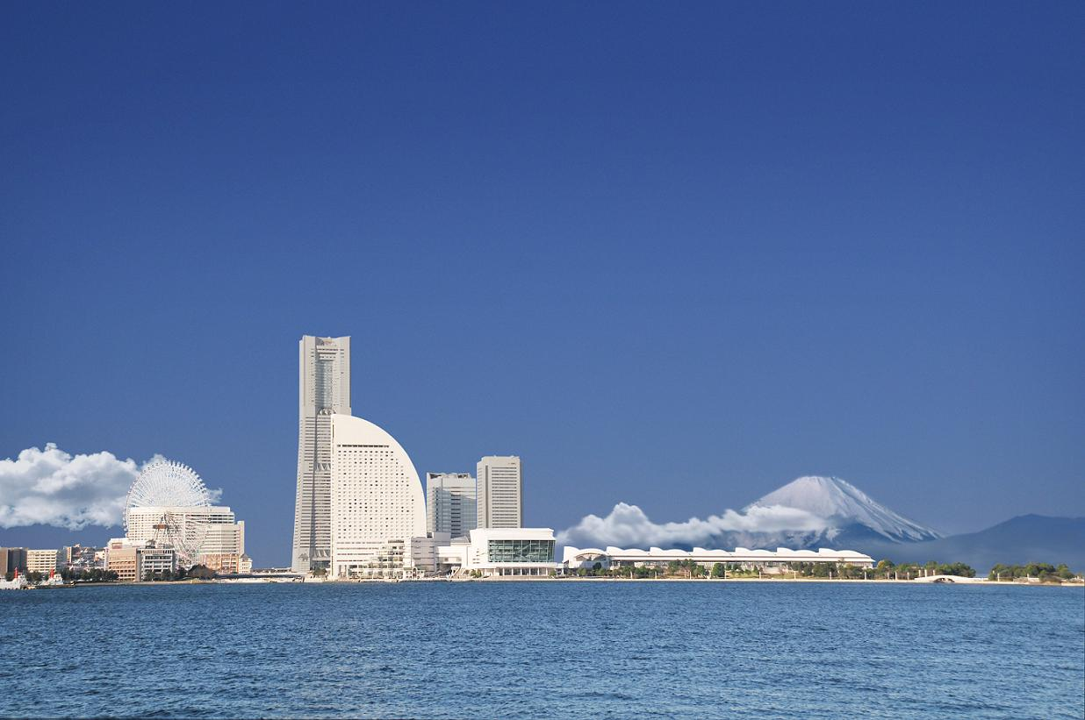
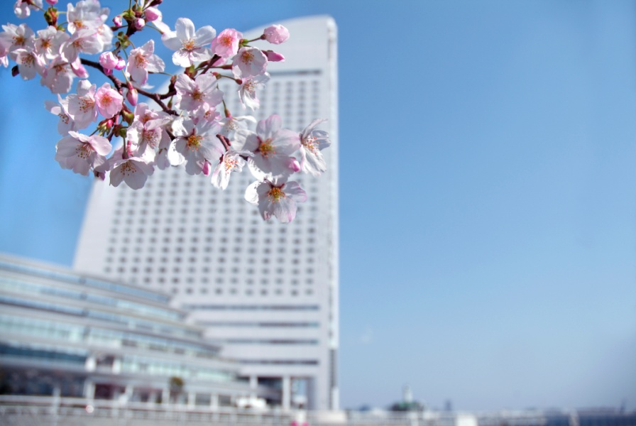
See you in YOKOHAMA!
http://www.icp2016.jp/

